Slide 1
Data Analysis Report Bright Alorwoyie

Slide 2
Project analysis slide 2
Outline
Dataset 1 Overview
Dataset 2 Deep Dive
Dataset 1 Deep Dive
Comparison of Datasets
Dataset 2 Overview
Insights and Way Forward

Slide 3
Project analysis slide 3
Dataset 1 Overview
3.69k
1.03k
27.9 %
11.85k
42.61k
Total stock for the period
Total units of goods sold
Percentage of stock sold.
Total sales revenue
Expected revenue for the period

Slide 4
Project analysis slide 6
Dataset 1 Deep Dive
Top five regions according to revenue
Bono
Greater Accra
Ashanti
Western North
Bono East
Bono generated the highest revenue of GHS 1,835 equivalent to 15.49% of the total sales and was 505.11% higher than Upper West, which had the lowest Total June sales at 303.25
Across all 16 Regions, Total sales revenue ranged from 303.25 to 1835.﻿ Upper West recorded the least sales of GHS 303.25 equivalent to 2.51% of the total sales
The stocks have been put into three categories.
Out of the three categories, HOME and HOUSE CARE generated the highest revenue equivalent to 52.83% of the total sales revenue.
BODY AND HAND CREAM generated the least revenue.
Home and House Care products sold more in most (10) regions except for Ahafo, Ashanti, Bono East where Body and Hand Cream sold more. In Greater Accra, Upper West and Western, Antiseptic sold more
﻿Home and House Care sold most in Western North than any other region.
.
Generally, Modern Trade is most preferred channel of sale, it accounted 37.73% of sales revenue generated over the period.
Table top channel generated the least sales and accounted for 0.76% of the total revenue.
Camel earned 30.59% of the brands' total income. It is 611.8% more expensive than Rosatol, which earned the least money, and 1.99 times more higher than Dettol, which came in second place.
Apart from Camel, Madar and Nivea all the other brands sold less than 10% of their aggregate stock. Camel was sold in 15 regions, Madar in 11 regions.
.

Slide 5
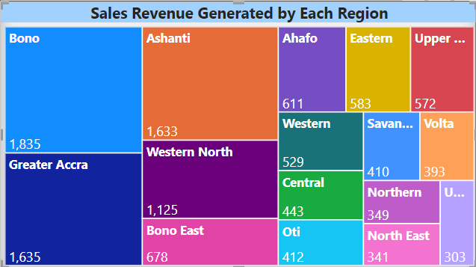
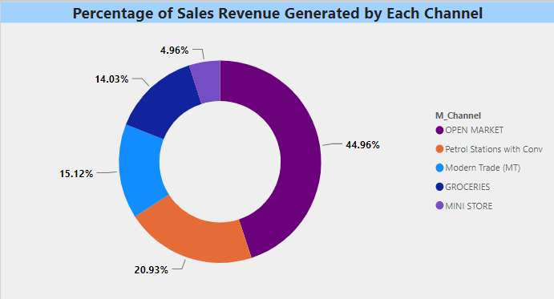
Project analysis slide 8
Dataset 1 key insights
There is a positive correlation between quantity sold and revenue generated.
Home and House Care category is the greatest influencers of sales in in the Bono Region.
Dettol brand influenced sales revenue the most in the Bono region contributing to 64.47% of the regions sales. Even though, more of Dettol products were sold.
A greater chunk of Bono region’s sales revenue was generated from the Open Market channel.
44.96% of the products in the Bono region were sold through Open Market channels
On a larger market scale, Camel brand generated the highest sales revenue of 30.59%. But most of its sales were generated in Western North.
Unlike Camel which is sold in all regions except Northern, Dettol is sold in only regions with Bono region as its main focus
Greater Accra has been identified to sell the highest volume of stock however it’s market flourished with the Madar brand which was also averagely priced lower than the Dettol brand

Slide 6
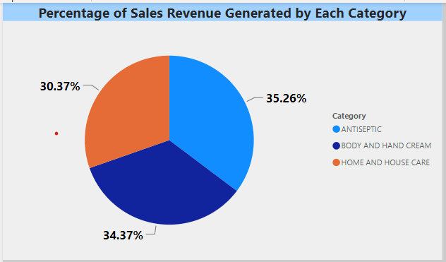
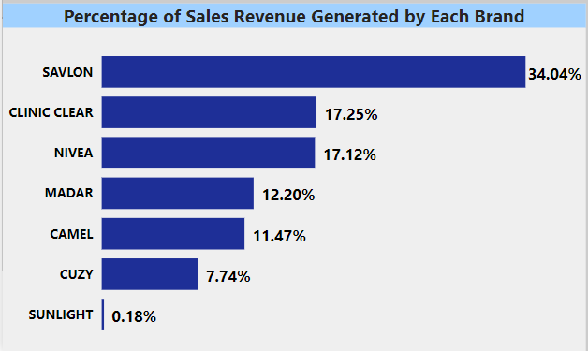
Project analysis slide 8
Dataset 1 key insights
The most thriving medium of sales in the Greater Accra region is Modern Trade which accounted for 63.3% of total sales revenue
However, sales revenue generated across the three categories in Accra do not vary so much.
Antiseptic generated 35.26% of sales, Body and Hand cream, 34.37% and Home and Hand Cream, 30.37%.
Ashanti region has relatively similar characteristics as Greater Accra
63.37% of stock sold in the Ashanti region was made through Modern Trade channel.
Savlon brand generated the highest lead in the Ashanti region, contributing about 26.94% to sales revenue.
Each of the categories were performing averagely well in sales revenue, however, Home and House Care topped the categories in the Ashanti region

Slide 7
Project analysis slide 3
Dataset 2 Overview
68.86K
35.29K
51.25 %
464.7M
760.1M
Total stock for the period
Total units of goods sold
Percentage of stock sold.
Total sales revenue
Expected revenue for the period

Slide 8
Project analysis slide 6
Dataset 2 Deep Dive
Top five regions according to revenue
Greater Accra
Bono East
Ashanti
Ahafo
Savannah
Greater Accra had the highest Sales Revenue and was 19,595.49% higher than Northern, which had the lowest Sales Revenue.
﻿Greater Accra accounted for 43.25% of the total Sales Revenue.
﻿Across all 16 Region, Sales Revenue ranged from 1,020,613.47 to 201,014,777.76.﻿
﻿In Greater Accra, BODY AND HAND CREAM generated 79.75% the Sales Revenue and was 849.93% higher than ANTISEPTIC, which had the lowest.
Generally, Stock from ANTISEPTIC category sold the most accounting for 53.96% of total stock sold during the period.
﻿Generally, Petrol Stations with Conv was the most used channel by clients. It generated 41.31% of the total Sales Revenue for the period.﻿.
Nivea is the most preferred brand and it accounted for 55.68% of total revenue generated by the brands.
It is 4.69 times higher than Clinic Clear which is the second highest and 5,568 times higher than Rosatol the lowest.
﻿61.68% of Nivea products were sold at Petrol Stations and 28.92% through Modern Trade.
Generally, Camel brand sold most in relation to stock accounting for 29.44% of total stock sold.
However, it generated only 3.73% of total revenue

Slide 9
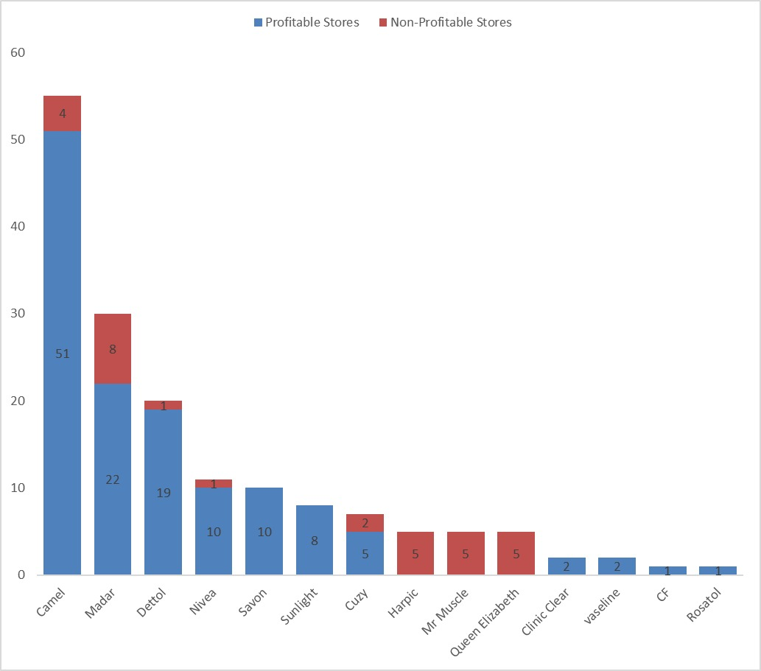
Project analysis slide 10
Store profitability by brands
Out of the 162 ﻿stores, Total Count of Distribution Intelligence was higher for Profitable Stores (131) than Non-Profitable Stores (31).
﻿CAMEL in Distribution Intelligence made up 31.48% of Count of Distribution Intelligence.﻿
﻿Count of Distribution Intelligence for Profitable Stores and Non-Profitable Stores diverged the most when the Brand was CAMEL, when Profitable Stores were 47 higher than Non-Profitable Stores.﻿
﻿

Slide 10
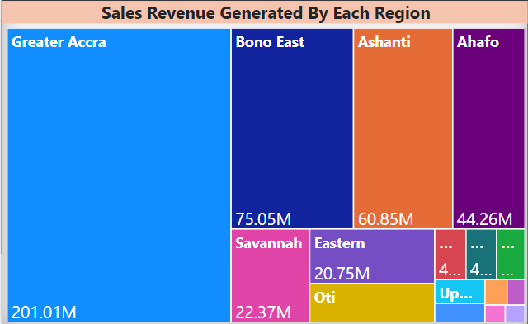
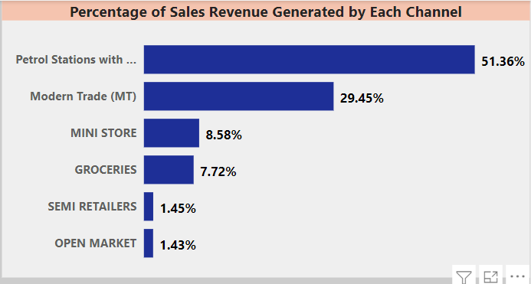
Project analysis slide 8
Dataset 2 key insights
There is a positive correlation between quantity sold and revenue generated.
Greater Accra generated the highest sales revenue of 201.01M
Body and Hand Cream category is the greatest influencers of sales in in the Greater Accra Region.
Nivea brand influenced sales revenue the most in the Greater Accra region contributing to 60.24% of the regions sales.
A greater chunk of Greater Accra sales revenue was generated from Petro Stations with Conv.
51.36% of the products in the Greater Accra region were sold at Petrol Stations with Conv.
On a larger market scale, Camel’s stock sold about 2.91 times more than Nivea but it did not generate as much revenue as Nivea.
This implies that the Nivea brand is priced much higher than the Camel brand

Slide 11
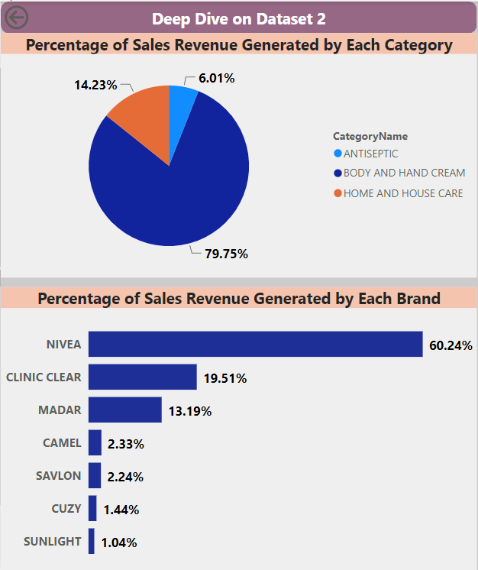
Project analysis slide 8
Dataset 2 key insights
The most thriving medium of sales in the Greater Accra region is Petrol Stations with Conv.
About 41.31% of sales made in the Greater Accra region was done through Petrol Stations.
Body and Hand Cream has been the most dominant brand that generated the most sales revenue.
It generated 75.23% of the total sales revenue
It also accounted for 79.75% of the total sales revenue generated in Greater Accra
In Bono East (the second highest sales revenue generating region), Body and Hand Cream generated 99.88% of the total sales revenue. Home and House Care category was not sold in Bono East at all
Nivea generated 89.78% of sales revenue in the Bono East region
Grocery stores are the main channels of distribution in the Bono East Region.
Modern trade was rarely used as it contributed only 0.04% to sales revenue

Slide 12
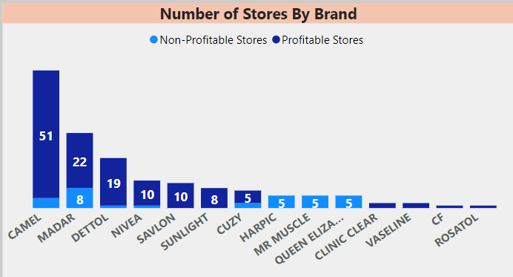
Dataset 2 key insights
Total Count of Distribution Intelligence was higher for Profitable Stores (131) than Non-Profitable Stores (31).﻿﻿
﻿﻿CAMEL in Distribution Intelligence made up 31.48% of Count of Distribution Intelligence.﻿﻿ ﻿﻿
﻿﻿Average Count of Distribution Intelligence was higher for Profitable Stores (11.91) than Non-Profitable Stores (3.88).﻿﻿
Count of Distribution Intelligence for Profitable Stores and Non-Profitable Stores diverged the most when the Brand was CAMEL, when Profitable Stores were 47 higher than Non-Profitable Stores.﻿﻿ ﻿﻿ ﻿

Slide 13
Project analysis slide 8
Comparison
Dataset 1
Dataset 2
Bono region generated the highest revenue, its most preferred medium of sale Open Market.
Home and Body Care Category of Products had the largest market share accounting for 52.83% of revenue
Demand for Body and Hand cream category of products was the least contributing only 20.26% to revenue
Modern Trade has been the most used channel of distribution
Greater Accra generated the highest sales revenue. Its most preferred channel of sales was Petrol Stations
Body and Hand Cream category of products had the largest market share of 75.23%
Demand for Body and Hand Cream products has seen a steep increase generating 75.23% of total revenue
Similarly, Modern Trade is generally the most preferred means of distribution

Slide 14
Project analysis slide 8
Insights and Way Forward
Consumer preference is changing overtime, hence the need for continuous market research and analysis
Bono East clients have much preference for Body and Hand Cream products. Consequently, this has caused an upward shift in their sales revenue, placing the region second.
The drop in sales revenue for Bono from first position to tenth was influenced by change in consumer preference. Introduction of Body and Hand creams in Bono should be considered
Modern Trade has generally been the most preferred channel of sales, however, innovative ways should be employed to optimize sales in markets with different preferred channels.

Slide 15
Thank You

